Slide 1


Department of Computer Science and Engineering
A CASCADED ENSEMBLE BASED YOUTUBE SPAM COMMENTS DETECTION USING MACHINE LEARNING
Chegireddy Keerthana [211419104046]
Shalini B [211419104244]
Swathi S [ 211419104282]
Dr. A. Hemlathadhevi, M.E., Ph.d.
Dr. K. Valarmathi, M.E., Ph.d.,

Slide 2
Introduction
YouTube features a spam filtering mechanism, although it consistently fails to do so effectively.
YouTube creators can monetize if they have more than 1,000 subscribers and 4,000 hours of watch time for the last 12 months.
The spam comments are being created to promote their channels or videos in popular videos.
The cascaded ensemble technique are most efficiently used to find the spam comments.

Slide 3
Objective of the Project
Being acknowledged will have a profoundly positive impact on YouTube content creators.
The automatic fact-checking procedures is the second reason.

Slide 4
Literature Survey
YEAR | TITLE AND JOURNAL | AUTHOR | DESCRIPTION | ADVANTAGES | DISADVANTAGES
2022 | "A YouTube Spam Comments Detection Scheme Using Cascaded Ensemble Machine Learning Model," in IEEE Access | H. Oh | Algorithms like Decision tree, Logistic Regression, Naïve Bayes and SVM are used. Ensemble Soft voting ESM-S is performed. https://drive.google.com/drive/folders/13GtJ3x34fyqDoZm_fe3iIf5fYXb0zaSH?usp=sharing | Enhances the accuracy of the classification | Time consuming, TF-IDF technique is not used
2023 | “Hybrid ensemble framework with self-attention mechanism for social spam detection on imbalanced data” in Expert Systems with Applications | Sanjeev Rao, Anil Kumar Verma, Tarunpreet Bhatia | The datasets are balanced using NearMiss and SmoteTomek techniques to feed several machine-learning models | The ensemble models are evaluated on imbalanced and balanced datasets. | OSN spam is a critical problem that needs to be addressed.

Slide 5
Literature Survey
YEAR | TITLE AND JOURNAL | AUTHOR | DESCRIPTION | ADVANTAGES | DISADVANTAGES
2023 | A review of spam email detection: analysis of spammer strategies and the dataset shift problem. Artificial Intelligence Rev 56 | Jáñez-Martino, F., Alaiz-Rodríguez, R., González-Castro, V | Spam email filtering has been tackled using different machine learning approaches including NB, SVM, Random Forest (RF) or Neural Networks (NN), among others | The accuracy remains above 83.50%83.50% in all cases | Effective strategies able to tackle the dataset shift and adversarial manipulation problems are necessary in order to handle security attacks and detect spammer corruption in data
2022 | YOUTUBE SPAM COMMENTS DETECTION",at Journal of Engineering Sciences | Gubbala Pranathi , Sri.S.K.Alisha, Sri.V.Bhaskara Murthy | The survey for the spam comments detection methodology has been carried out using four Artificial Intelligence estimations – Logistic Regression, Ada Boost, Decision Tree and Random Forest. | With the use of Neural Network, achieve an exactness of 91.65% and beat the present course of action by around 18%. | Due to over fitting in the data it is not accurate compared with other algorithms.

Slide 6
Literature Survey
YEAR | TITLE AND JOURNAL | AUTHOR | DESCRIPTION | ADVANTAGES | DISADVANTAGES
2022 | A Hybrid Spam Detection Framework For Social Networks | Oğuzhan ÇITLAK, Murat DÖRTERLER, İbrahim Alper DOĞRU | It is aimed to detect spam accounts on social network and the spam detection policy of these networks is intended to support. Keywords are Social networks, spam detection, short link analysis, machine learning, text analysis. | The success of a spam account detection model based on the social networks that developed is 95.69%. | When analysing a large dataset, it may take a little more time due to these limitations.

Slide 7
Problem Statement
The way to detect spam comments is through cascaded ensemble method which will be the focus of the study. Cascaded Ensemble follows two methods ensemble hard voting and soft voting. Experimentation with several traditional machine learning models to set a baseline and then compare results to the state-of-the art deep networks to classify the stance between spam and ham comments.
Spam comments can be come in many forms, including: outright false stories, fake giveaways or the stories which are developed to mislead and influence reader’s opinion. While spam comments may have multiple forms, the effect that it can have on people, government and organizations may generally be negative since it differs from the facts.
Detecting spam comments is hard for many reasons. Assessing the veracity of YouTube comments are a complex and cumbersome task, even for trained experts. These complexities make it a daunting task to classify spam comments.

Slide 8
Proposed System
The Cascaded Ensemble technique is used. ESM-H(Ensemble Hard voting) is the most efficient technique for YouTube spam comments detection as it is less time consuming.
The algorithms used are Logistic Regression, Random Forest and Multinomial Naïve Bayes.
TF-IDF vectorization technique is used.

Slide 9
Software / Hardware used
Operating System : Windows 10 or later
Tool : Anaconda with Jupyter Notebook
Processor : Intel i3
Hard disk : minimum 80 GB
RAM : minimum 2 GB

Slide 10
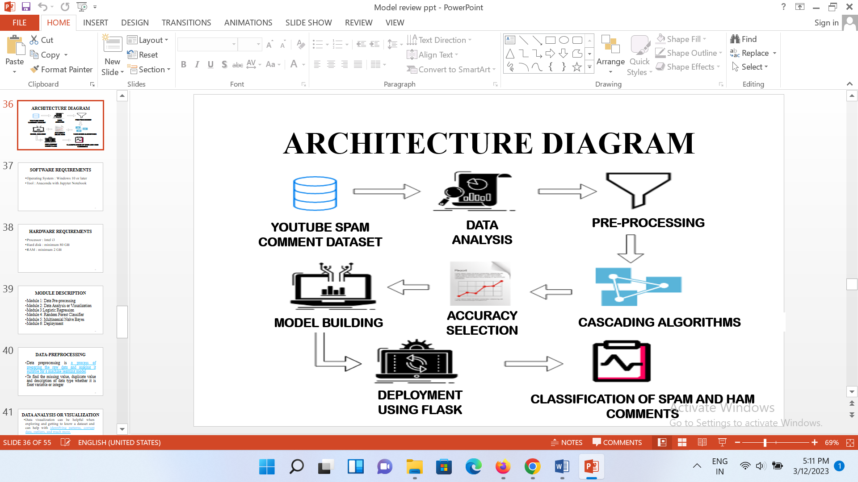
Architecture / Methodology used

Slide 11
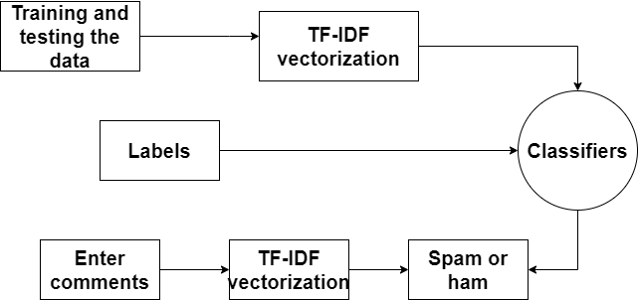
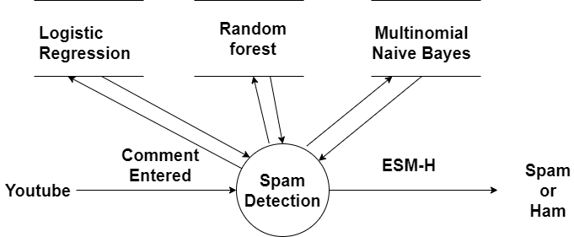
System Design - Flow Chart/DFD/ER
Level 0 DFD:
Level 1 DFD:

Slide 12
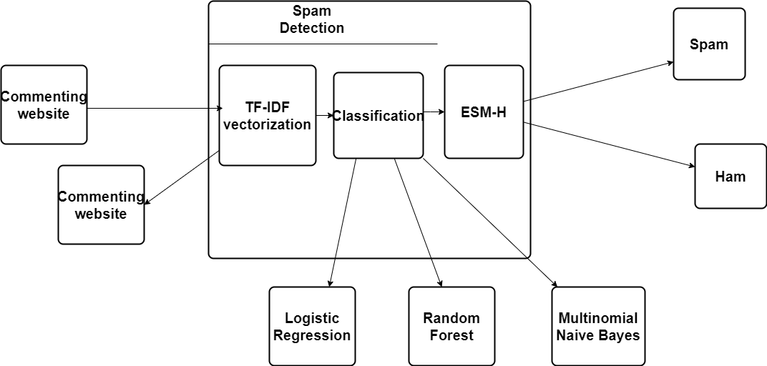
System Design - Flow Chart/DFD/ER
Level 2 DFD:

Slide 13
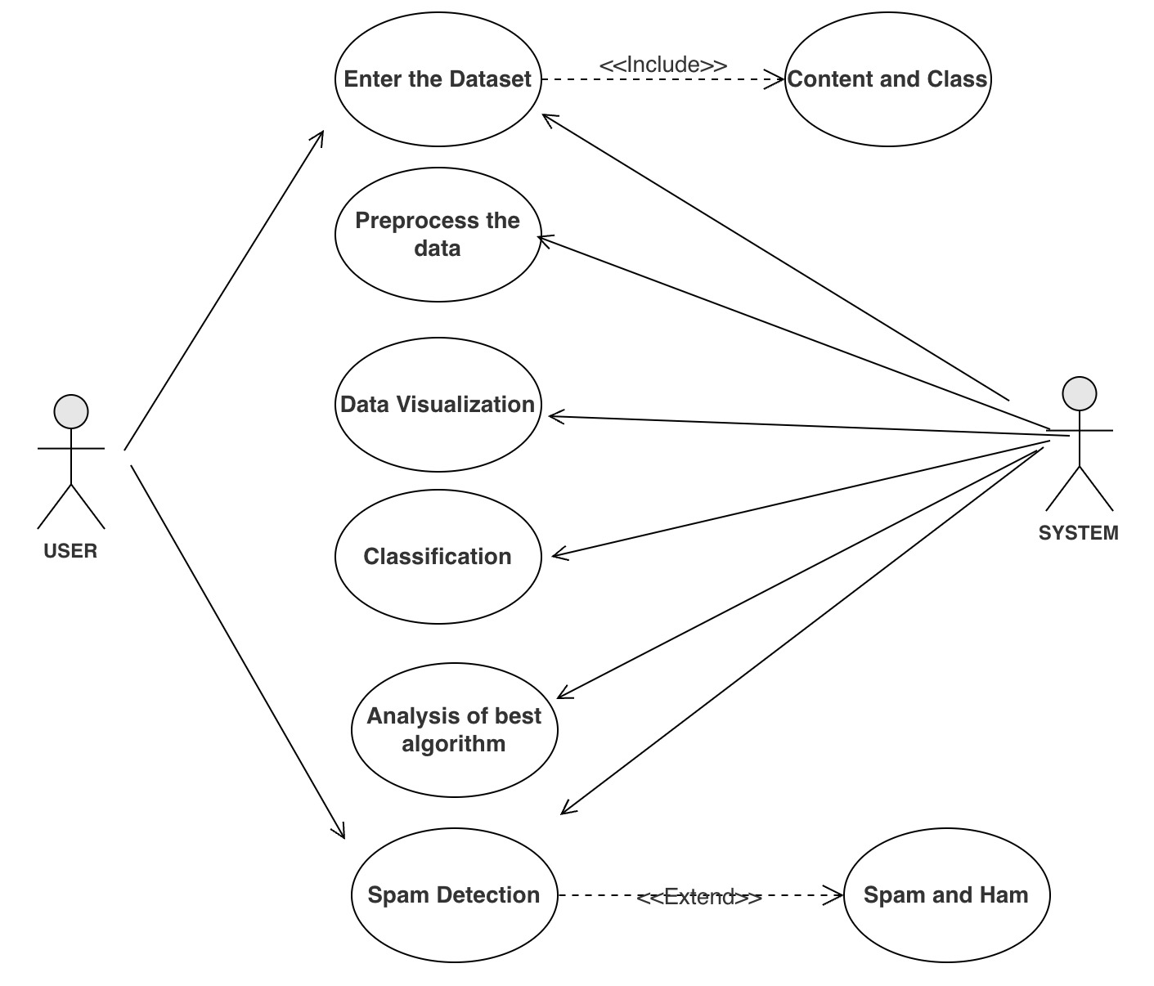
System Design - Flow Chart/DFD/ER
USECASE DIAGRAM

Slide 14
Module Description
Module 1: Youtube ID train model
Module 2: Data Analysis
Module 3: Classifications
Module 4: Analysis Performance

Slide 15
Module 1: YOUTUBE ID: TRAIN MODEL
The datasets is given as the input which is the comments from famous music videos. They contain YouTube ID, comment author, date, comment content, and labeled class (0: Ham or 1: Spam).Comment content and labeled class are only used. This dataset is used to train the model.
COMMENT_ID | AUTHOR | DATE | CONTENT | CLASS
LZQPQhLyRh80UYxNuaDWhIGQYNQ96IuCg-AYWqNPjpU | Julius NM | 2013-11-07T06:20:48 | Huh, anyway check out this you[tube] channel: ... | 1
LZQPQhLyRh_C2cTtd9MvFRJedxydaVW-2sNg5Diuo4A | adam riyati | 2013-11-07T12:37:15 | Hey guys check out my new channel and our firs... | 1

Slide 16
Module 2: DATA ANALYSIS
Data visualization can be helpful when exploring and getting to know a dataset and can help with identifying patterns, corrupt data, outliers, and much more.
With a little domain knowledge, data visualizations can be used to express and demonstrate key relationships in plots and charts that are more visceral and stakeholders than measures of association or significance.

Slide 17
Module 3: CLASSIFICATION
LOGISTIC REGRESSION
Logistic regression is commonly used for prediction and classification problems. It is used to classify based on 1 and 0. The formula to calculate logistic regression is:
log[y/1-y]= b₀+b₁x₁+b₂x₂+b₃x₃+…b_{n}x_{n}
It calculates each tag's likelihood for a given sample and outputs the tag with the greatest chance.
P(α|β) = P(α) * P(β | α)/P(β)
RANDOM FOREST CLASSIFIER
In the Random forest model, a subset of data points and a subset of features is selected for constructing each decision tree. Simply put, n random records and m features are taken from the data set having k number of records.
RFfi_{i}=(Σ_{j∈alltrees} normfi_{ij})/T
Where:
RFfi sub(i)= the importance of feature i calculated from all trees in the Random Forest model
normfi sub(ij)= the normalized feature importance for i in tree j
T = total number of trees
MULTINOMIAL NAÏVE BAYES
The Multinomial Naive Bayes algorithm is a Bayesian learning approach popular in Natural Language Processing (NLP).

Slide 18
MODULE 4: ANALYSIS PERFORMANCE
The best accuracy is given by Random forest algorithm from Ensemble Hard voting(ESM-H) method.
The algorithm is checked by construction of a deployment model and verifying it.
Flask is used to connect the algorithm with the front end.

Slide 19
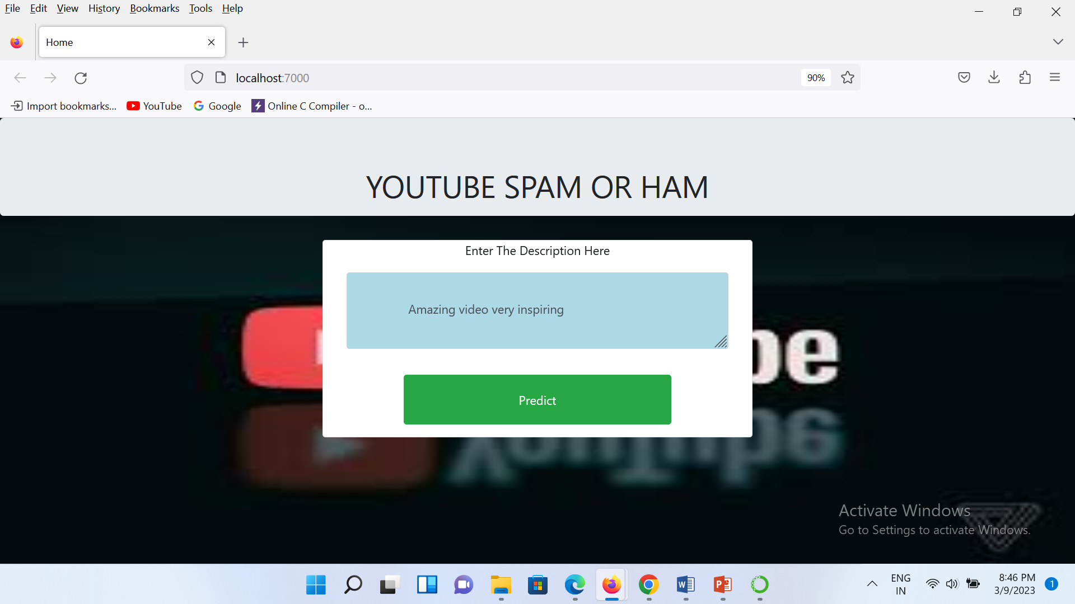
Screen Shots

Slide 20
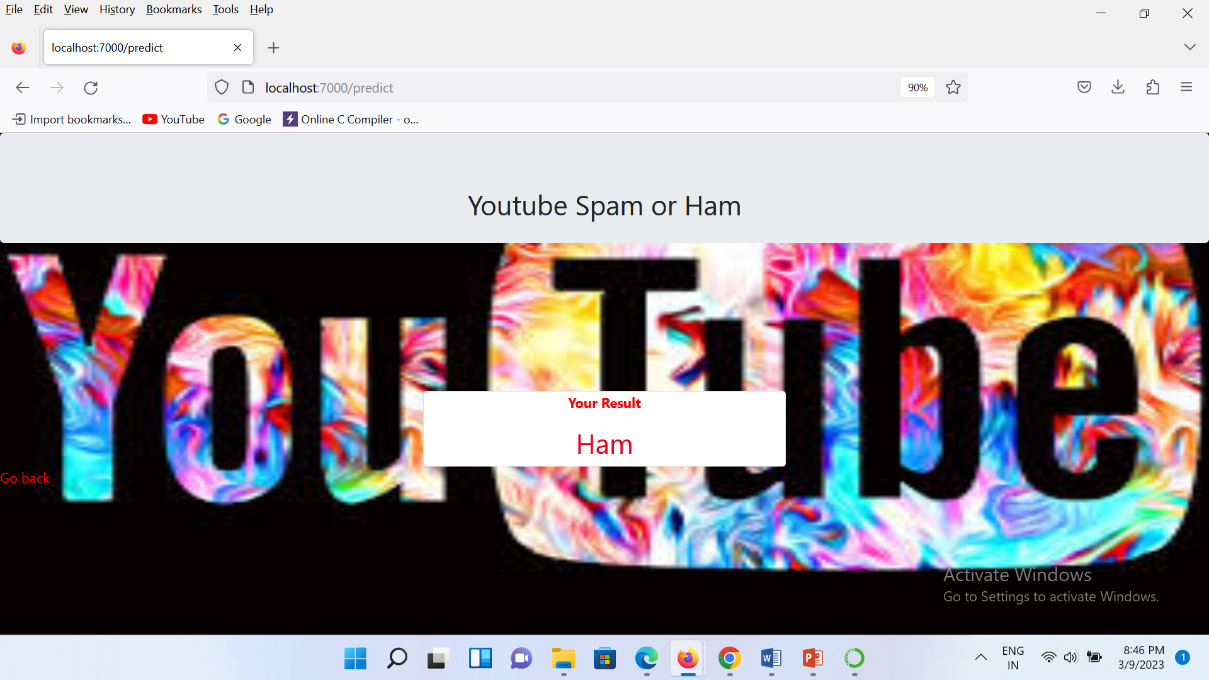
Screen Shots

Slide 21

Screen Shots

Slide 22

Screen Shots

Slide 23
Conclusion / Feature Enhancement
Based on the undertaken experiments, it is expected that existing classifiers that were widely used the features in detecting comment spams are the most efficient set of algorithms.
The best accuracy on public test set of higher accuracy score algorithm are found.
The found one is used in the deployment which can help to find the YouTube spam comment.

Slide 24
Reference Paper/ URL
[1]H. Oh, "A YouTube Spam Comments Detection Scheme Using Cascaded Ensemble Machine Learning Model," in IEEE Access, vol. 9, pp. 144121-144128, 2022, doi: 10.1109/ACCESS.2022.3121508.
[2]Gubbala Pranathi , Sri.S.K.Alisha, Sri.V.Bhaskara Murthy Mca Student, Senior Assistant Professor, Associate Professor Dept Of Mca B.V.Raju College, Bhimavaram et al, "YOUTUBE SPAM COMMENTS DETECTION",at Journal of Engineering Sciences , 2022, Vol 13 Issue 07,2022, ISSN:0377-9254
[3] Çıtlak, Oğuzhan & Dörterler, Murat & Doğru, İbrahim, (2022). A Hybrid Spam Detection Framework for Social Networks. Journal of Polytechnic. 10.2339/politeknik.933785.
[4] Sanjeev Rao, Anil Kumar Verma and Tarunpreet Bhatia, “Hybrid ensemble framework with self-attention mechanism for social spam detection on imbalanced. data” ,Expert Systems with Applications,Volume 217,2023,119594,ISSN 0957-4174
[5] Abid, M.A., Ullah, S., Siddique, M.A. et al. Spam SMS filtering based on text features and supervised machine learning techniques. Multimed Tools Appl 81, 39853–39871 (2022). Doi:10.1007/s11042-022-12991-0
[6] Aakanksha Sharaff, Chandramani Kamal, Siddhartha Porwal, Surbhi Bhatia, Kuljeet Kaur, Mohammad Mehendi Hassan, et al, “Spam message detection using Danger theory and Krill herd optimization”, Volume 199,2022 ,108453,ISSN 1389-1286.

Slide 25
THANK YOU

